Slide 1
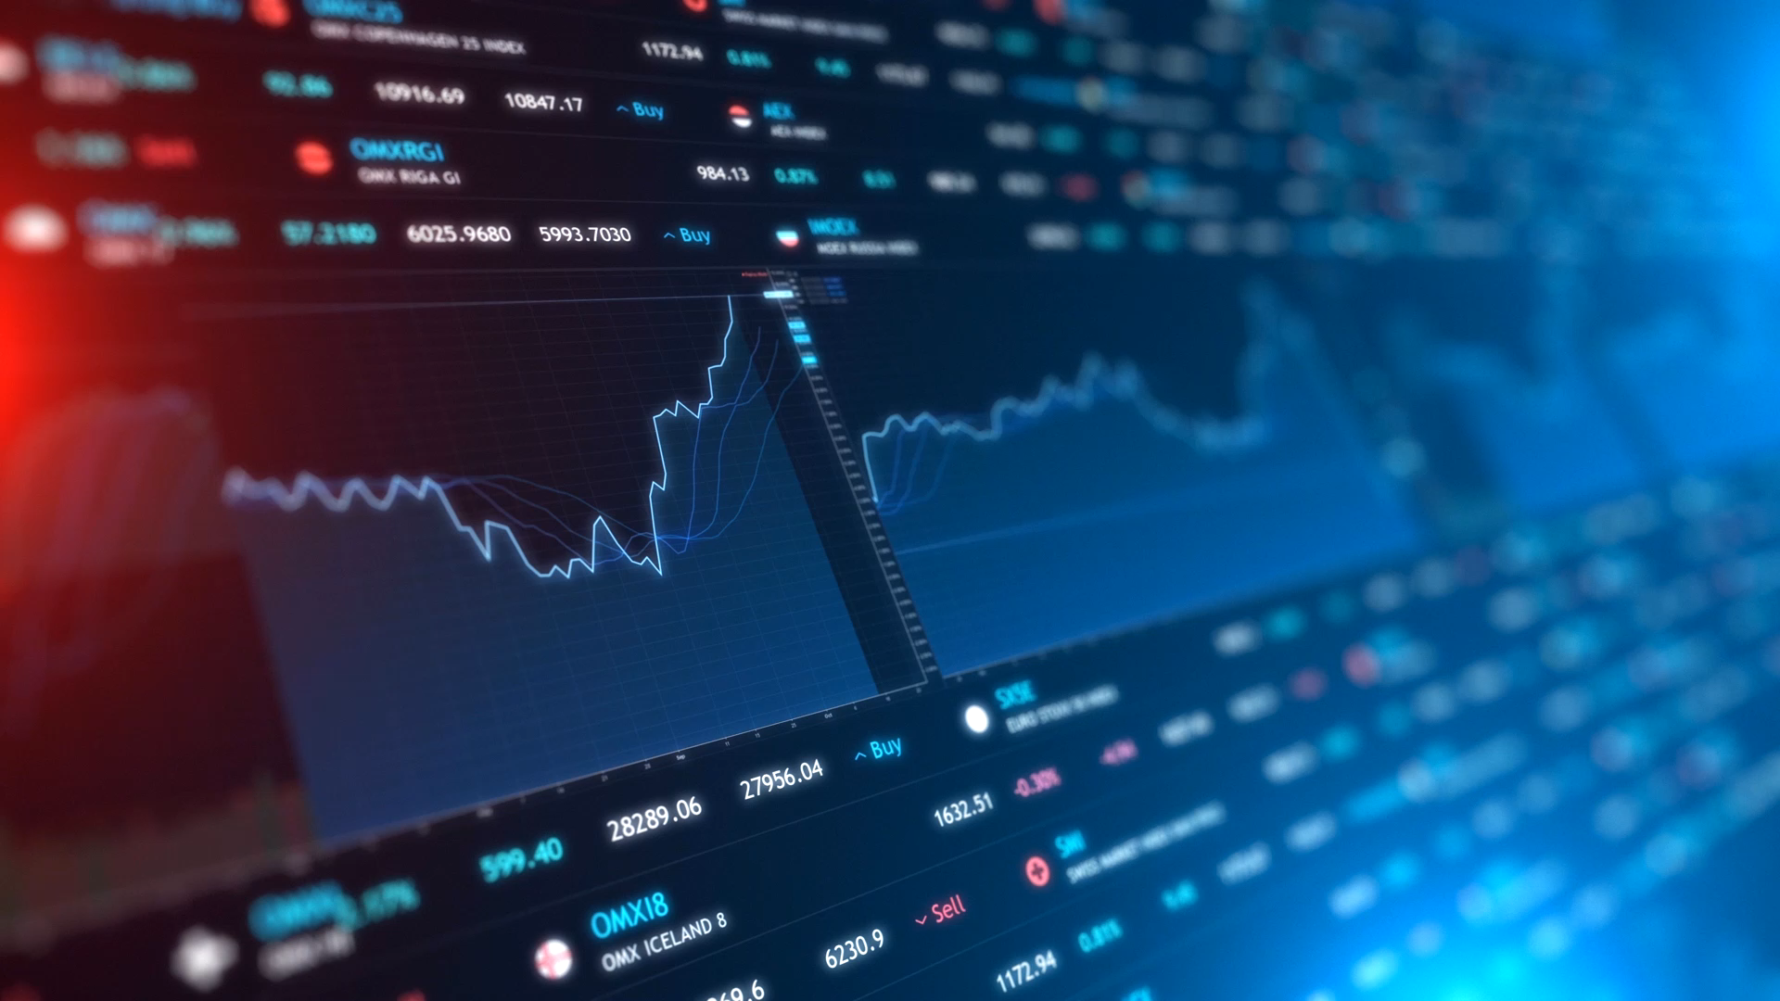
Trend Analysis with Confidence Measure for Crypto and Other Assets

Slide 2
CS 7641 – Machine Learning TEAM 6
Karan
Youngsuk
Tien
*Symmetric Noise
Vikas
Himanshu

Slide 3
Introduction
Stock Market involve multivariate probabilities and is very sensitive to external and random noise which makes the price prediction very challenging and often meaningless.
Trend or the direction of the price can however be estimated with a fair accuracy using a combination of technical indicators and machine learning techniques on a soft assignment basis.
Cryptocurrencies has gained a lot of traction recently and has openly available datasets (live and historical) to test our models effectively.

Slide 4
Problem Statement
Most of the currently employed machine learning techniques have been used to predict the future prices of an asset on different timeframes without risk or confidence measures.
Limitations on usage of heavily relied upon technical indicators like RSI, MACD etc. in conjunction with the present models. A lot of successful traders rely on signals from multiple indicators to make a decision which needs to be accounted for in our model.

Slide 5
Models
Unsupervised Learning :
Principal Component Analysis for dimensionality reduction
Supervised Learning:
- Decision Tree – help us identify a set of 2-3 indicators that perform best in predicting stock trend
- Linear Models: Ridge Classifier, Logistic Regression
- Support Vector Machine (SVM)
Reinforcement Learning :
We will test this method as it could work well for time series problems.
Data Set :
Binance API – Multiple timeframes and historical data available

Slide 6
Unsupervised Learning - PCA

Slide 7
Supervised Learning – Decision Tree
Used sklearn.tree.DecisionTreeClassifier
Considered 8 commonly used indicators ( SMA21, SMA50, EMA21, EMA50, RSI, MFI, ADX, ATR ) as features, among which 3 of them are randomly selected and provided as features to the decision tree
The classification is done separately for 'BUY' or 'Long' and 'SELL' or 'Short' based on the truth labels
Repeated the process several times and selected the indicator set with the highest accuracy as the most relevant indicators to be used.

Slide 8
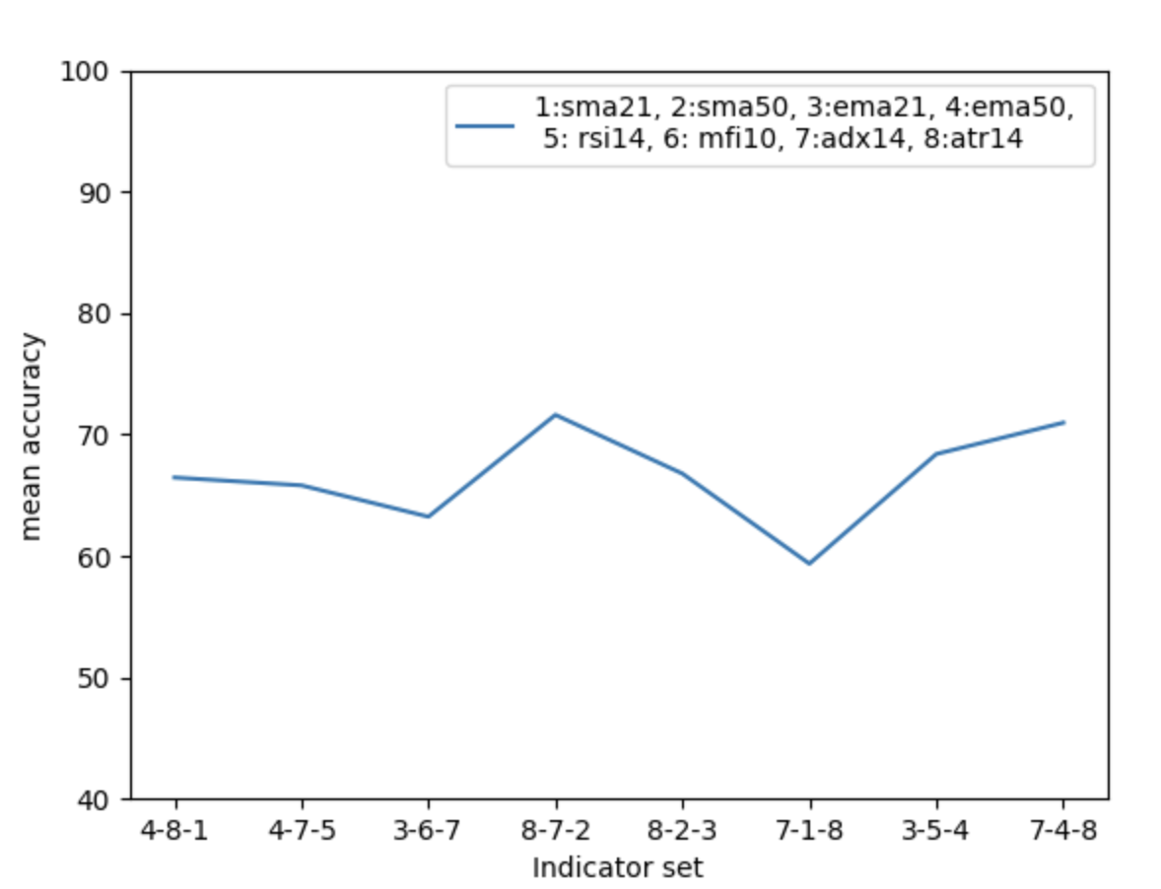
Supervised Learning – Decision Tree
We observe that the combination 8-7-2 or (ATR, ADX and SMA50) provides the best estimate of the trend among the selected indicators as it has the highest accuracy.
The focus here is not on the absolute metric of accuracy but rather the relative measure of accuracy among different indicator sets as shown below: Indicator sets: ['4-8-1', '4-7-5', '3-6-7', '8-7-2', '8-2-3', '7-1-8', '3-5-4', '7-4-8'] Accuracy : [66.45, 65.80, 63.22, 71.61, 66.77, 59.35, 68.38, 70.96]

Slide 9
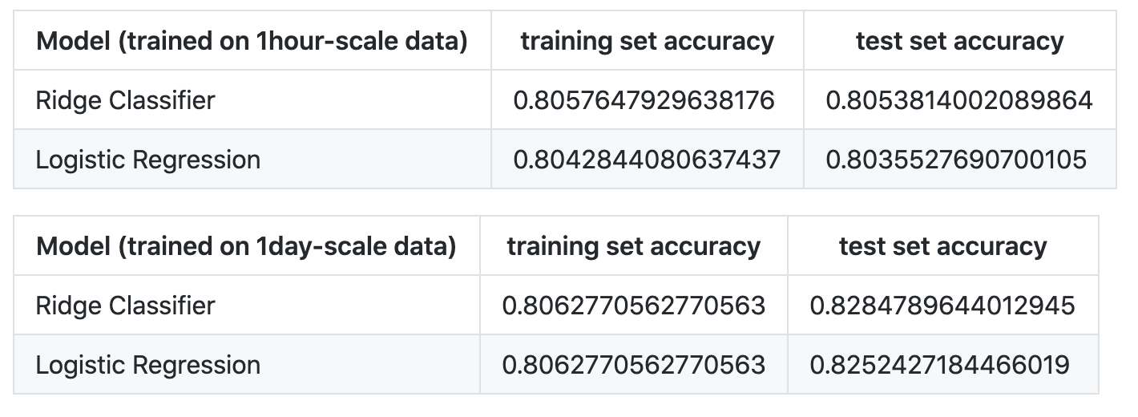
Supervised Learning – Linear Models
Used Ridge Classifier and Logistic Regression
We achieved a high accuracy of 80% on our original unbalanced datasets. After truncating the original dataset to balance it, we obtained the results as below:

Slide 10
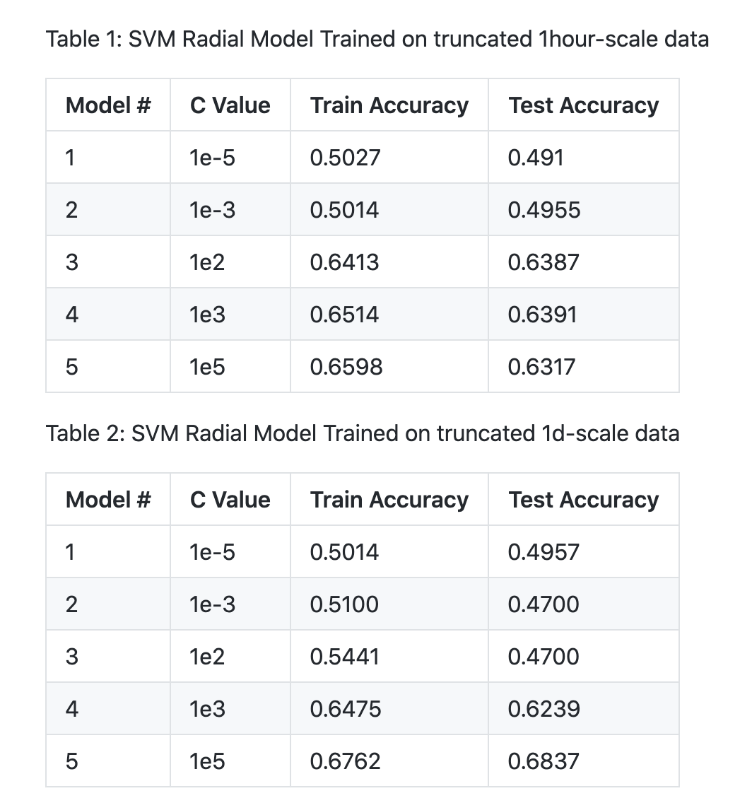
Supervise Learning - SVM
We checked the accuracy of the SVM model on various C Parameter and decided to pick C = 10^3 as an optimum value.
The SVM model trained on the truncated datasets provide the test set accuracy of around 63% on C=1e3 . The model results look promising, and we will continue to explore more on how we can improve the accuracy.

Slide 11
Reinforcement Learning
Used

Slide 12
Discussion
We plan to employ proven technical indicators along with our model to make our decisions. Decision Trees could be used for this purpose and future scope could also involve using clustering techniques to group similarly trending assets to create a portfolio or diversify the risk.
Long-short term memory architecture has been found to be good for predictive analysis and this method could be experimented with our model to measure the results with classical techniques such as regression and SVM.

